Slide 1
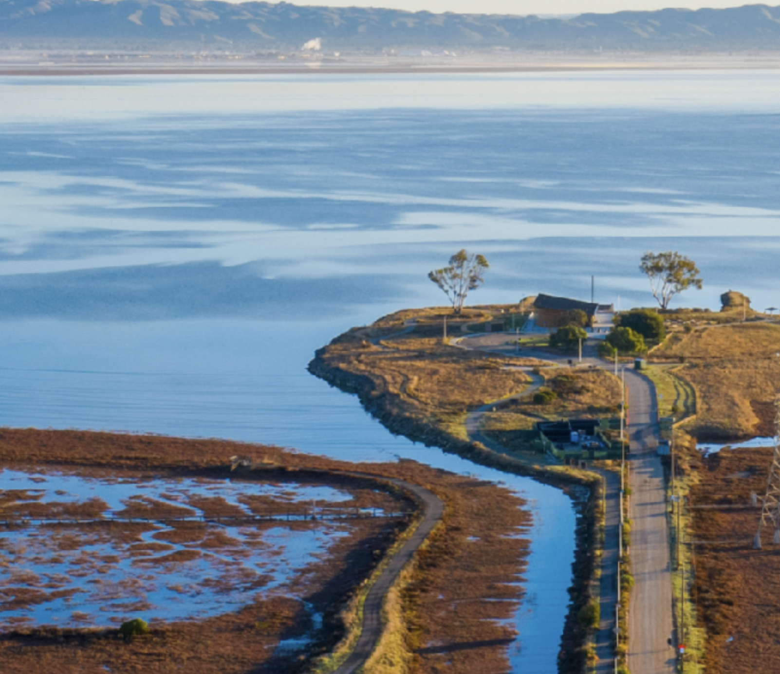

East Palo Alto Talks 2026
Our City, Our Future,
Our East Palo Alto

Slide 2
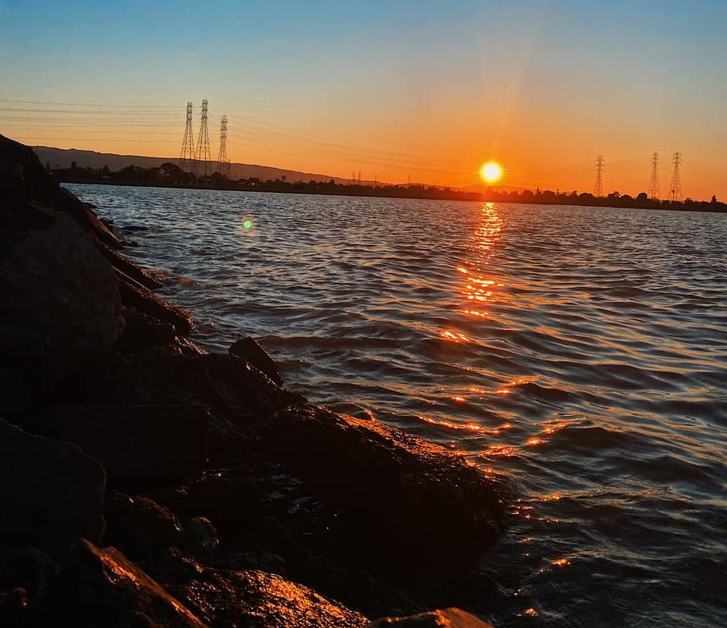
We are Listening!
We are excited to launch EPA Talks once again to discuss the issues that matter most in our City.
As always, your voice matters and we want to hear from you!

Slide 3

What is EPA Talks?
East Palo Alto Talks is an interactive community conversation to discuss City service needs and priorities.
We are inviting YOU to participate and give your feedback.

Slide 4

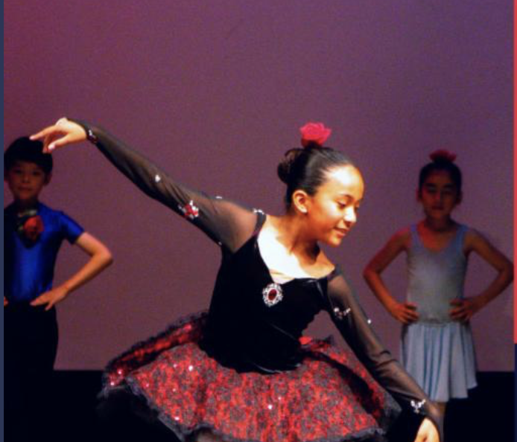
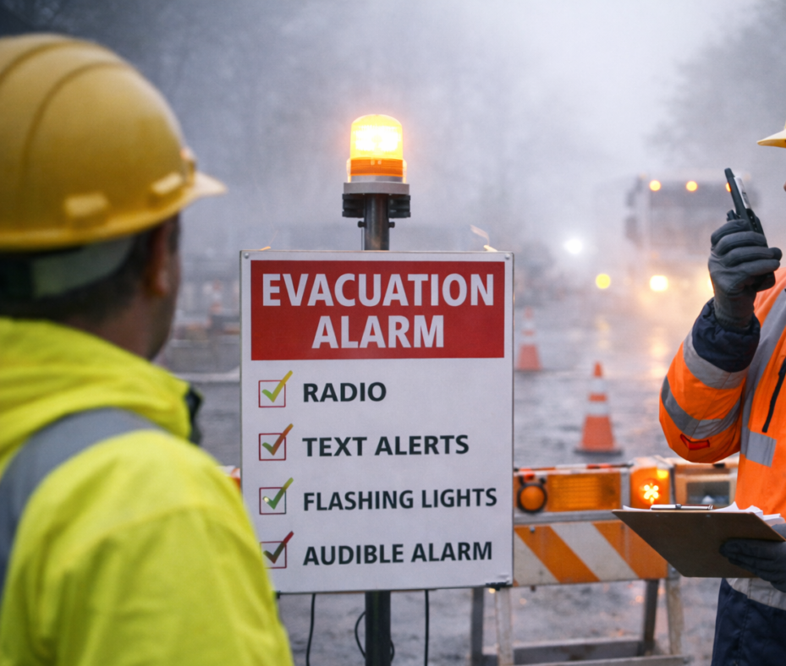
What Are My Neighbors Saying?
In 2026, East Palo Alto residents have identified the following City priorities:
Providing safe and clean drinking water
Replacing deteriorating pipes that distribute drinking water
Providing safe places for children and teens
Repairing aging storm drains to prevent flooding on City streets
Providing an Emergency Operations Center ensuring a safe place in East Palo Alto no matter the emergency

Slide 5
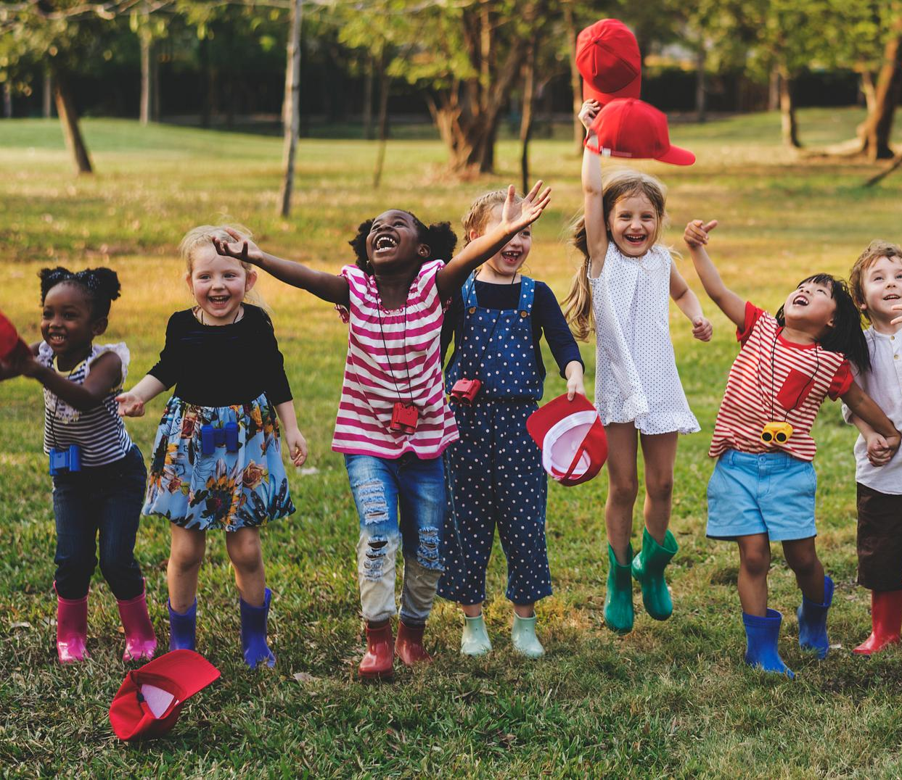
Safe Places for Children
East Palo Alto is sorely lacking safe places for youth to spend time after school and in the summer.
East Palo Alto needs to be able to invest in the future of our youth by providing dedicated spaces for children and youth to play and gather – keeping them safe and out of trouble.

Slide 6
East Palo Alto’s Library & Infrastructure
The East Palo Alto library has not been significantly renovated in 40 years.
Other City buildings have leaky roofs, faulty heating and cooling systems and outdated electrical wiring.
Our library is run-down, deteriorating and overcrowded with wait lists for literacy and children’s programming due to lack of space.
The City’s vision is for a modern library with up-to-date technology, hands on learning and maker spaces, and dedicated areas for children and teens so they have somewhere safe to go after school and in the summer.

Slide 7
East Palo Alto Civic Center
East Palo Alto was incorporated as its own city in the 1980s — yet we still do not have our own community center, police station, or library facility designed to meet today’s needs.
By creating the East Palo Alto Civic Center, we can:
Strengthen self-determination
Maintain local control over our future
Deepen connection within the community
Reduce reliance on outside agencies

Slide 8
NOW WE WANT TO HEAR FROM YOU!
Please share your perspectives on our "East Palo Alto Talks" online community survey
<link survey/QR Code>

Slide 9
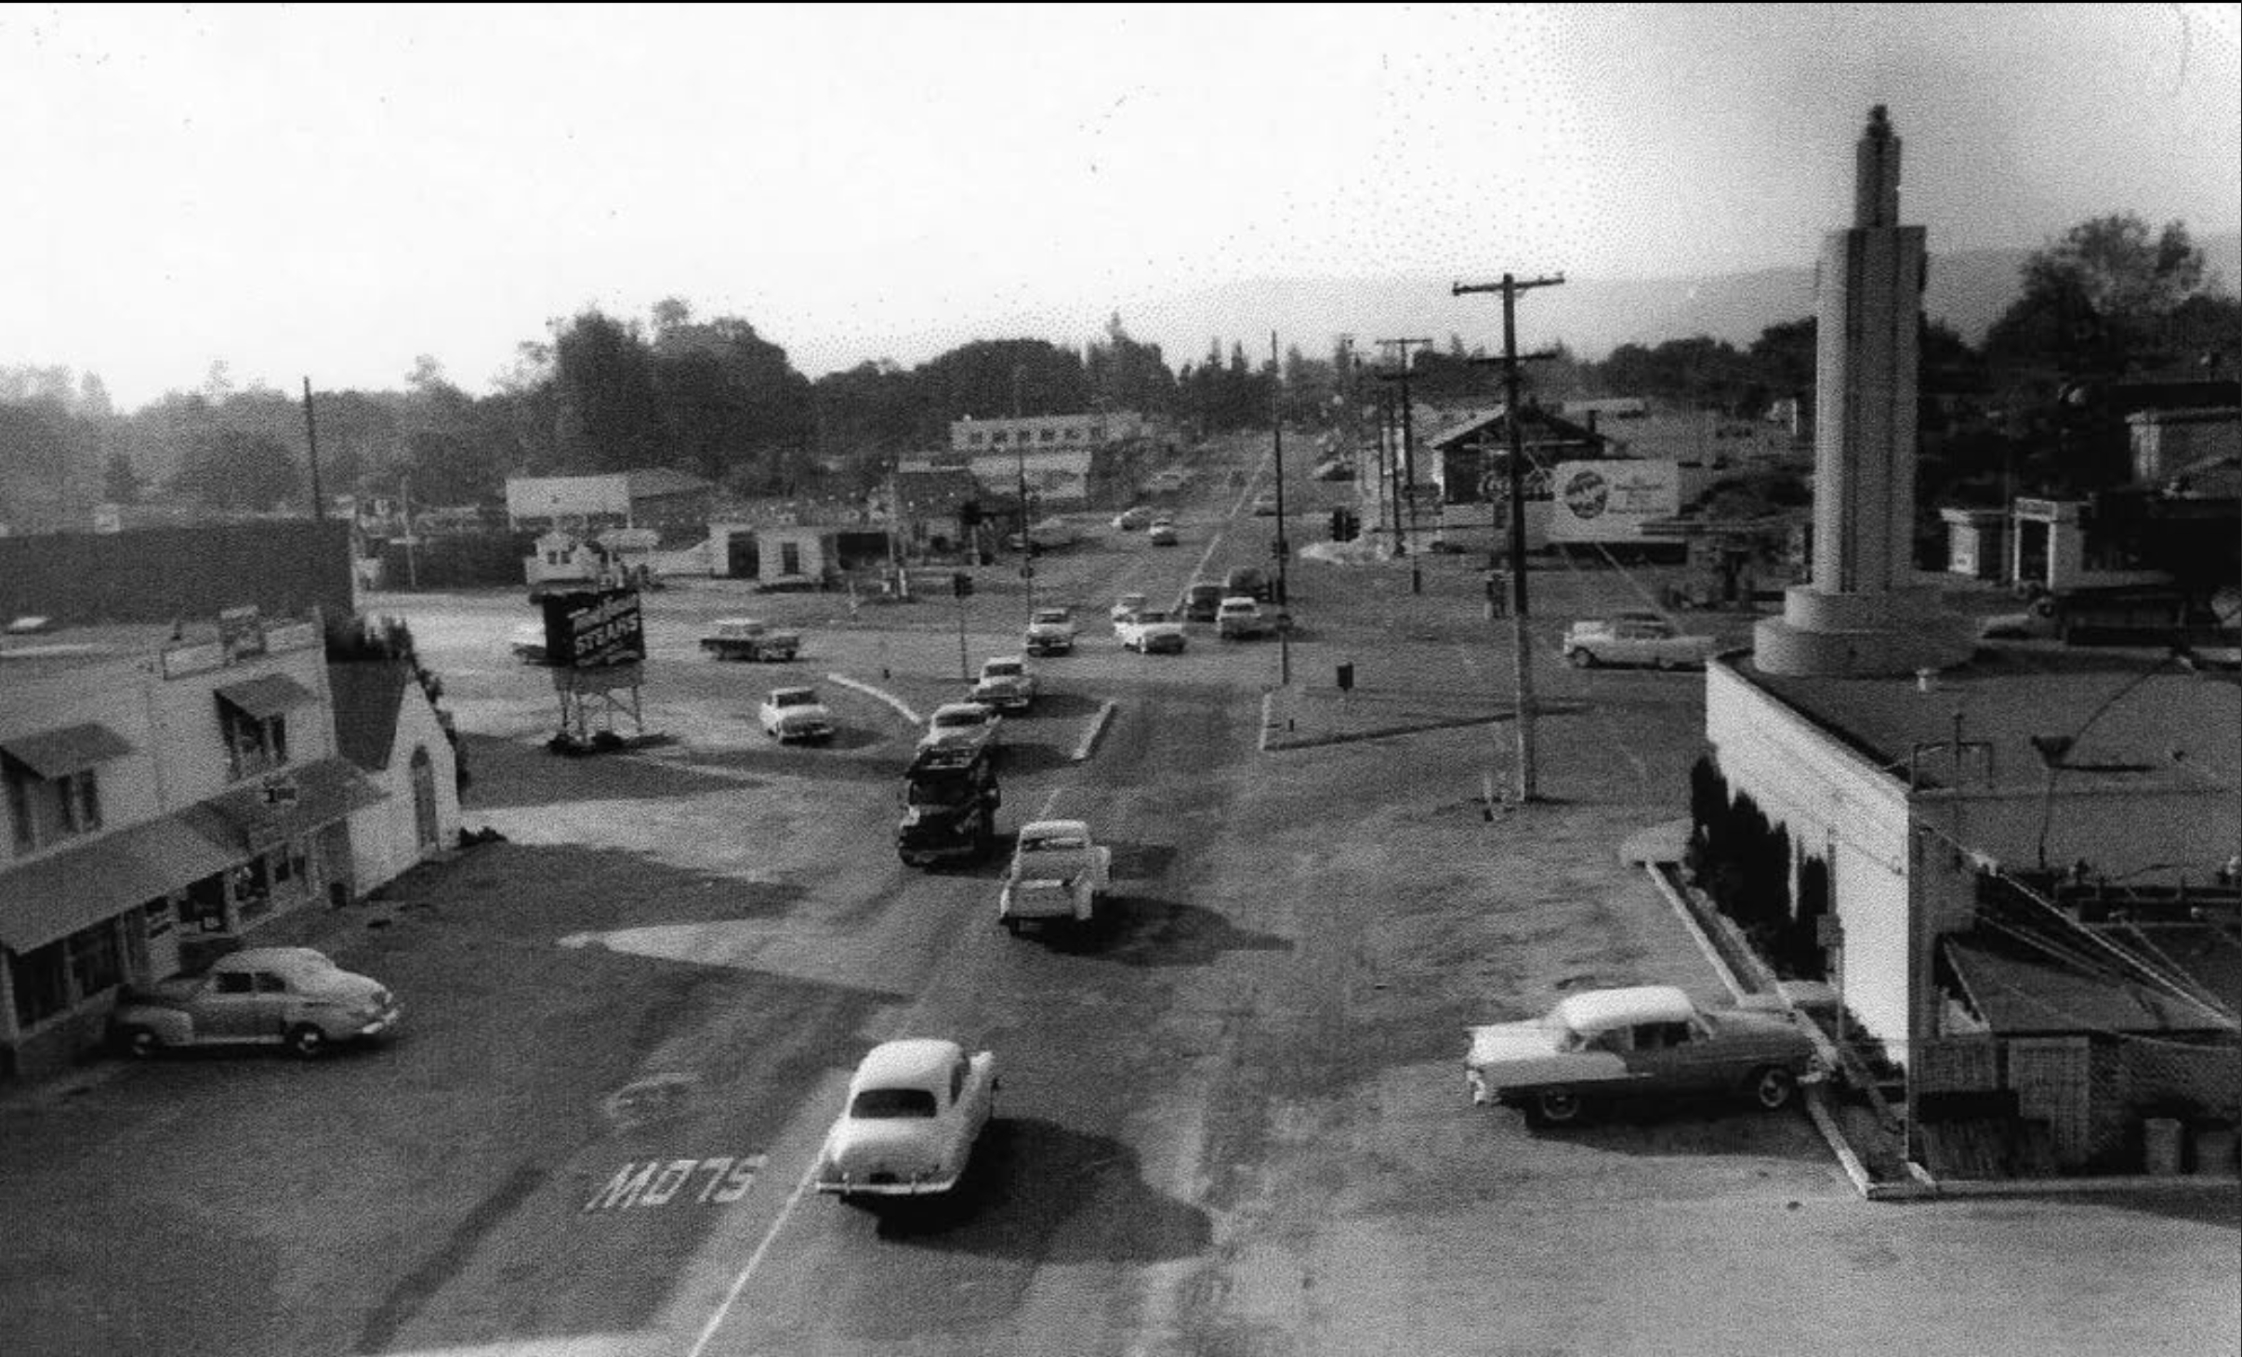
QUESTIONS?

